Slide 1

Salad with crab sticks
Sklyarov Nikolay

Slide 2
Ingredients:
ham - 400 grams
crab sticks - 1 pack
canned corn - 1 can
tomatoes - 4 pieces
green onions - 50 grams
dill - 50 grams
croutons - 2 packs
mayonnaise - 200 grams

Slide 3
Instraction:
Dice the ham and tomatoes, finely chop the crab sticks, grind the green onions and dill, add the canned corn, mix everything, salt, pepper and season with mayonnaise. Add croutons before serving.

Slide 4
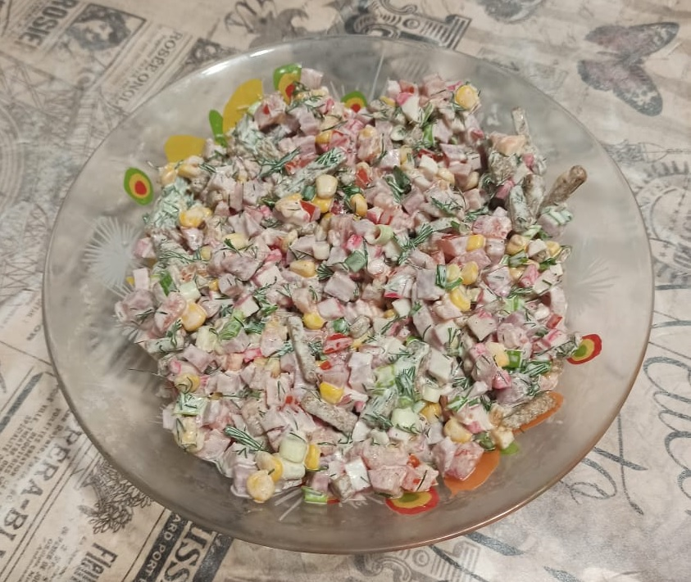
Bon Appetit!

